Slide 1
WARDEN AND Clerk Training
2024 elections
Haverhill City Clerk’s Office

Slide 2
De-escalation Training
Haverhill Police Department –
Sgt. Taylor Ray and Lt. Nick Brown
https://youtu.be/rCWt7gDwEPc?si=87B3606KkEoOvyGE

Slide 3
Mark your calendars
Presidential Primary Election – March 5, 2024
State Primary Election – September 3, 2024
State/Presidential Election – November 5, 2024

Slide 4
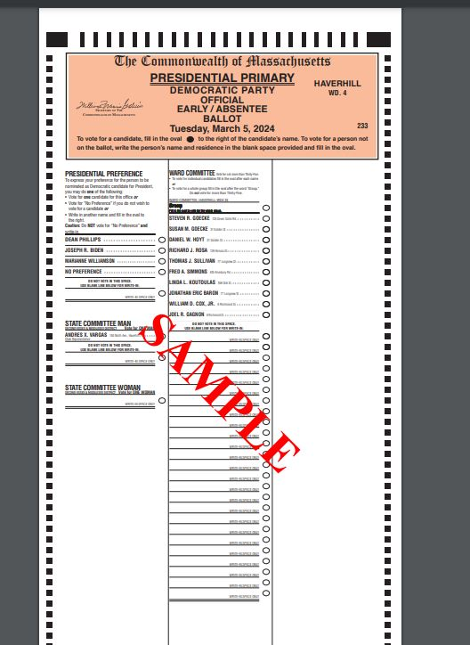
What will the ballot look like?
Locations with sub-precincts will have 2 ballot styles
There will be Democrat, Republican, and Libertarian ballots

Slide 5
Inspectors
Please contact your inspectors to confirm they are able to work the election immediately
The weekend before the election call your inspectors to remind them of the election and confirm they are able to work
If they are unavailable, let us know immediately so we can find a replacement for you

Slide 6
OPENING OF THE POLLS
Pre-election Team Meeting conducted by Warden
Post specimen ballots, demonstration ballots, Voter Bill of Rights and precinct map. Ensure that access to them is not blocked.
“How to Vote” signs in booths – English and Spanish
Turn on the AutoMARK machine
Count ballots into groups of 50
The Public has a right to view the opening procedures.

Slide 7
ImageCast 2 tabulators
Once the tabulator is plugged in and turned on, make sure the middle light of 3 lights on left front of machine is green
Green means go!!!
If your tabulator is not showing a green light…
Call the Clerk’s Office

Slide 8
Early Ballots
Absentee/Early Ballots CANNOT BE ACCEPTED AT THE PRECINCT ON ELEC TION DAY. The voter MUST return the ballot to the Clerk’s office at City Hall.

Slide 9
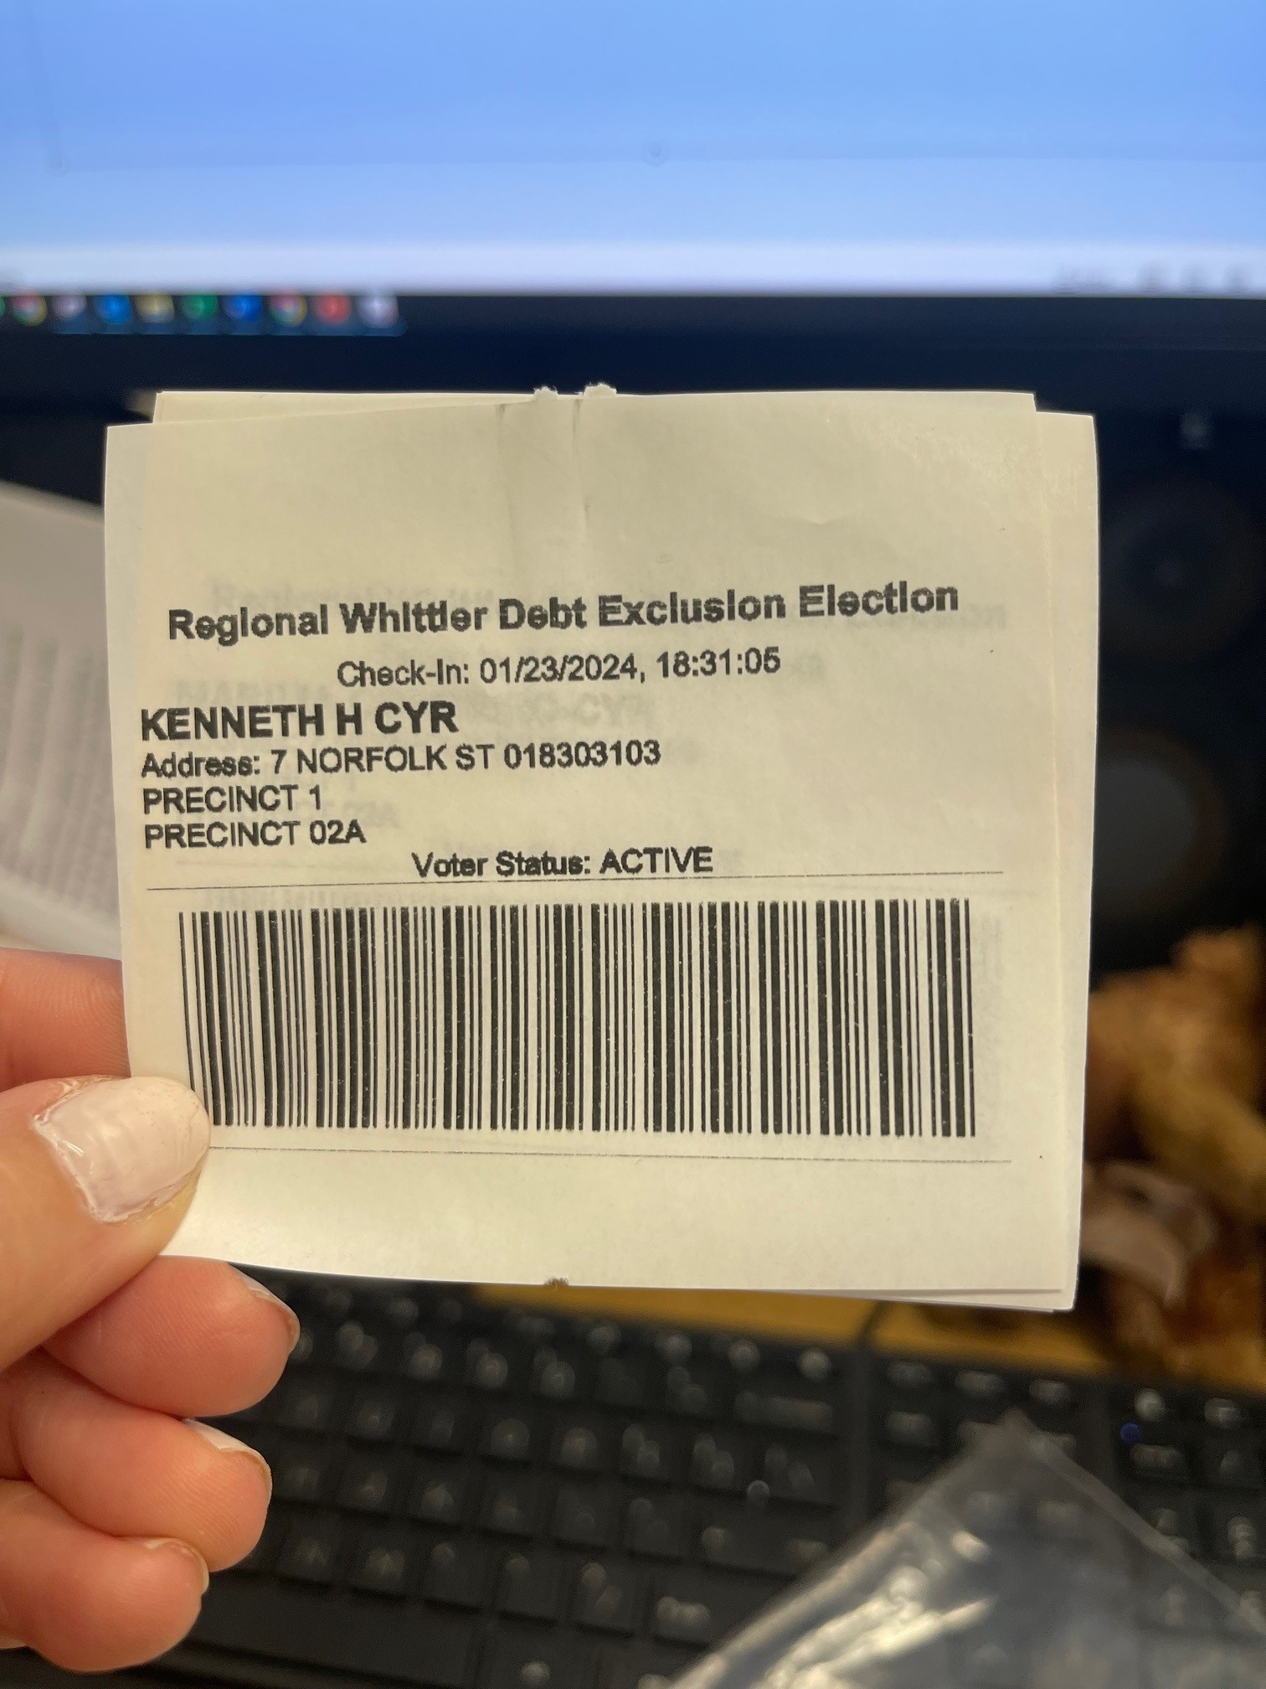
Poll Pads & Sub-Precincts
Separate slips by precinct and sub-precinct
End of night you will need these numbers separate
We will provide you with two small boxes to keep the slips separate
Slips show party, precinct/sub-precinct, and will also show ballot style

Slide 10
Poll Pad Check-in Numbers for Sub-precincts
To determine the total number of check-ins for your precinct vs your sub-precinct, follow the steps below:
Select Menu
Select option → Summary Report
Select option → All Check-Ins
Select option → Precincts
From the drop down, choose the precinct or sub precinct you are looking for to determine the total number of check-ins
Write the number determined in your Clerk’s Log and on Tally Sheets
Repeat steps 1-6 to determine the number for the other precinct/sub-precinct you are looking for

Slide 11
INACTIVE VOTERS
Reasons A Voter is Inactive
Did not return the annual census
Has not voted in several past elections
Skipping one election will not make you inactive
May have returned census and voted, but recently changed their registration and the acknowledgement notice was returned to our office as undeliverable
This could be a change initiated at the RMV or other state agencies

Slide 12
INACTIVE VOTERS, CONT’D
Acceptable Forms of ID:
Massachusetts Driver’s License
Car Registration
Payroll Check Stub
Current Utility Bill
Current Bank Statement
Current Lease/Rental Agreement/Rent Receipt

Slide 13
INACTIVE VOTERS, CONT’D
If voter’s ID, does not match their registration
Have them fill out inactive roster with updated address

Slide 14
OBSERVERS
THE VOTING PROCESS MAY BE OBSERVED BY PEOPLE NOT VOTING
Observers will be listening for the name and address of the Voter
Repeat the name and address of the voter in a loud, clear voice so the observer can hear
Observers may not interfere with the voting process in any way, and they are not allowed to speak to Poll Workers or Voters
Observers must refrain from using cell phones in the Precinct

Slide 15
OBSERVERS
Observers cannot walk through the precinct to check the number on the ballot box, under any circumstances
Hang the ballot box count sheet in a viewable area
Example
https://www.youtube.com/watch?v=3xYXUeSmb-Y

Slide 17
MEDIA
Media is allowed, but they cannot go further then the check in table
No pictures of ballots allowed or up close photos of voters voting
Poll workers MAY NOT make any statements to the press regarding the number of votes for any candidate or race, who has or has not voted, or any other statement regarding the state of the polls generally.
*Let the Police know if there any issues with the Media*

Slide 18
Processing Vote-BY-MAIL BALLOTS
We will be pre-processing MOST of our Vote-By-Mail ballots
You will still receive some at your precinct
The Warden and Clerk MUST BE the individuals that are processing Vote-by-Mail ballots
Inspectors may check them into the poll pad, while Warden/Clerk reads the names and addresses (acting as the voter), but the Warden/Clerk must be the individual placing the ballot into the machine
If voter is inactive
Override the voter on the poll pad
Password is 1234
Since the ballot arrived to the voter via mail, we have essentially confirmed that they do indeed live at that address

Slide 19
Processing Vote-BY-MAIL BALLOTS
If voter has over or under voted
You will cast the ballot as is
This is because the voter is not there to confirm their wish, you must cast as is
This vote will count as a blank
Do not put in the auxiliary
This is unnecessary and will cause more work for you!

Slide 20
Auxiliary Ballots
Machine rejects the ballot, ballot box attendant must check the screen for the following possible messages (do not read the ballot):
Ballot not read, please re-insert
Overvoted Race
Blank
Invalid Ballot
If voter given wrong ballot, you will need to put in auxiliary and hand count
Ambiguous mark
If overvoted or blank, you may offer the voter a new ballot and review instructions when completing the ballot
Green (cast) and red (reject) button will light up
If voter refuses new ballot or voter is not present, cast ballot by selecting green button
Ambiguous mark
If voter is present, offer to spoil ballot and instruct them on how to properly complete the ballot
If voter is not present, you will need to place in auxiliary and hand count
Reject (red button) will only light up

Slide 21
Auxiliary Ballots
All auxiliary ballots will be tallied by warden and clerk at the end of night on Auxiliary Tally Sheet
Auxiliary ballots will be placed in Auxiliary Ballot Envelope once tallied
The Auxiliary Ballot Envelope (will be labeled) will be placed in the CAST BALLOT BIN, which will be sealed and top of bin signed by the Warden and Clerk at the end of the night

Slide 22
WRITE IN BALLOTS
Inspectors should INSPECT all ballots in main compartment for write-ins
Regardless of oval being filled in, if voter wrote in a name in the write in area for a race that should be tallied as a write in
This would change your tally on your tally sheets from a blank to a write in and should be updated accordingly on main tally sheet and write in tally sheet
Second Essex and Middlesex District Democratic State Committee Woman will have write-in

Slide 23
Ballot Jams
To prevent - when a voter is present or if they (poll worker) are casting EV/ABS ballots
Wait for the tabulator screen to read Please Insert Ballot at the top of the screen
If a ballot does jam, make sure you review the screen to see if results have saved before proceeding

Slide 24
SPOILED BALLOTS
Ballots are like baseball…three strikes you’re out
Voters are allowed the opportunity for three ballots
If they have spoiled three, unfortunately they are not allowed anymore
Spoiled ballots should be placed in the clear envelope labeled SPOILED BALLOTS and sealed in the UNCAST BALLOT BIN.

Slide 25
Provisional Ballots
What warrants a provisional?
Any person who claims the right to vote but does not appear on the Poll Pad, Voting List, or Alpha List
Please call the Clerk’s Office to verify if they are registered
Any person on the list with an ID flag, but does not have an acceptable ID
Do not confuse this with a challenged ballot

Slide 26
Residency Requirement
For statewide elections only the “6-month rule applies”
Voter who has moved can vote from previous address if:
Moved within MA
Moved within last 6 months
Did NOT re-register
Voter must complete Affirmation of Current and Continuous Residence
Special section for voters that have moved
If voter has been deleted, they will have to vote provisionally
Call Clerk’s Office to confirm

Slide 27
Provisional Ballot Procedure
If voter has “ID” flag next to their name, begin by notating the voter in the clerk’s log
Then complete the provisional ballot affirmation form
W/P in top right corner
Provisional ballot number in top left corner
Have the voter complete rest of form and give back to Warden/Clerk
Once form completed, ask voter for ID
If ID provided, record in Precinct Election Official box in lower left corner
If ID is license, include license number.
Even without ID, voter must still be allowed to cast provisional ballot.
The warden/clerk should then add the voter’s name, address, DoB, provisional ballot #, and reason code to Provisional Voting Roster
Hand the voter a ballot with provisional written at the top center and a manila envelope with ballot #, W/P completed
Once voter has voted, they should return ballot to you sealed in manila envelope and paperclip the affirmation form to the outside of the ballot
Place in “Provisional Ballot” Envelope
VERY IMPORTANT!!!!
DO NOT PUT IN THE BALLOT BOX
DO NOT PUT IN CAST BALLOT BIN
PLEASE RETURN ALL PROVISIONALS WITH THE POLICE OFFICER DURING THEIR 2ND TRIP BACK TO CITY HALL

Slide 28
Challenged Ballots
Reasons to challenge
Voter is not who they say they are
Voter does not reside at the address they claim
Voter not qualified
Age
Can be initiated by a voter, observer, or warden
Include on ballot name and address of challenger and voter and reason for challenge

Slide 29
End of night pROCEDURES
It is very important that the warden and clerk work together to print tapes and shut down the machine
One should read the manual, while the other does the actual machine work
DO NOT HIT RE-ZERO!!!!
You should never ever hit re-zero

Slide 30
Tapes at the End of night
Please cut the tapes, do not pull
This will help prevent issues

Slide 31
End of night
First trip
Three (3) ImageCast machine tapes – signed by Warden and Clerk
Two (2) memory cards from the ImageCast machine

Slide 32
End of night, CONT’D
Second Trip
Voter List
Completed Forms Envelope (even if empty)
Completed Provisional Ballots Envelope (even if empty)
Pink Plastic Envelope containing:
Tally Sheets and worksheets
Election Clerk’s Log
Preprinted inactive roster
Single inactive sheets
Keys for Automark
Poll pad slips
Second Trip
Blue Plastic Envelope containing:
Certificate of Service
Ballot Count
Key/fob to the ImageCast machine
Key for Automark
Red Supply Box
ImageCast Machine (in black strap bag)
Poll Pad (in green box)
Cast ballot box, signed and sealed
Uncast ballot box, signed and sealed
It is very important these are separate from one another and not mixed

Slide 33
end of night procedures
The empty manilla ballot envelopes for early voting/absentee should be put in the uncast ballot box at the end of the night (pink label)
The spoiled ballot plastic envelope with spoiled ballots inside should be put in the uncast ballot box at the end of the night (pink label)
Write-In and Auxiliary plastic envelopes are in the cast ballot bin (yellow label) and you should place the ballots in the envelopes and then in the bin at the end of the night before it is sealed
Go over list with police at end of night to they have everything they need

Slide 34
RESPECT FOR VOTERS
ALL UNITED STATES CITIZENS, REGARDLESS OF THEIR PROFICIENCY IN ENGLISH, HAVE THE RIGHT TO VOTE.
It is important that Poll Workers treat all Voters with respect, courtesy and customer service.
Voters with Disabilities - Use of Handicap Booth; Use of Automark Machine
Children in Voting Booths - Parents may bring their child into the voting booth with them.
Family Members in Voting Booths -Voters needing family members’ assistance may bring a family member into the voting booth.

Slide 35
POLITICAL DISCUSSIONS
There are to be ABSOLUTELY NO political discussions under any circumstances
Do not wear any sort of political attire
This goes for both you and the voter…
If the voter is discussing politics, you must ask them to take their discussion outside
If the voter is wearing political attire (someone on the ballot), you must ask them to leave and return without that article of clothing on
I.E. No Trump/Biden gear, LGB
If the voter causes an issue, get the Police Officer assigned to your precinct

Slide 36
SANDWICH!!!
How to politely say no
Positive
Negative
Positive
“Yes, your voting rights are important and we work hard to ensure the integrity of everyone’s vote. However, you cannot wear political gear in the precinct and must remove the political attire before voting. Once you have removed the attire or placed a sweatshirt over your shirt, we will gladly check you in and give you a ballot. I will even allow you to go to the head of line.”

Slide 37
EXPECTATIONS
The parking spots closest to the entrance MUST BE RESERVED FOR VOTERS. If you need a handicap spot, please remember that your car will be parked all day, and voters needing handicap spots throughout the day will not have access to it. Please use the spots as close as possible to the handicap spaces.
All workers should be on the lookout for voters who need assistance in the Precinct.
Do not leave your post without checking with the Warden
Dress in layers as requests for heat/air conditioning cannot be made to please everyone.
Be flexible. You may be asked to work in a different capacity than you are used to.
Keep your cell phone on vibrate/silent. Keep texting and social media to a minimum.
All Election Workers must stay in the Precinct until the votes have been counted and everything is balanced.

Slide 38
LUNCH BREAK AND PAY
All poll workers are allotted a two-hour lunch break
Please ensures that the warden and clerk are not on break at the same time
You must take your lunch break no later than 2 PM
All workers should be back from break by 4 PM
You will be paid $275 for the day
Checks will be issued two weeks after the election on Thursday March 21st

Slide 39
Make a Plan to Vote
Vote on Election Day if you work at your precinct or vote on lunch break
Early Voting
Vote by Mail

Slide 40
Contact Info
City Clerk Office
(978) 374-2312
Kaitlin’s Cell
(978) 697-0380
Rose’s Cell
(781) 910-4176
Text - if not-emergent
Call - if emergent

Slide 41
Call the office at the end of night
Please call the Clerk’s office with questions, especially at the end of the night
I need to focus on results
Cannot answer your call
I AM SORRY!!!

Slide 42
QUESTIONS?

