Slide 1
Inspector Training
2024 Presidential Election
Haverhill City Clerk’s Office

Slide 2
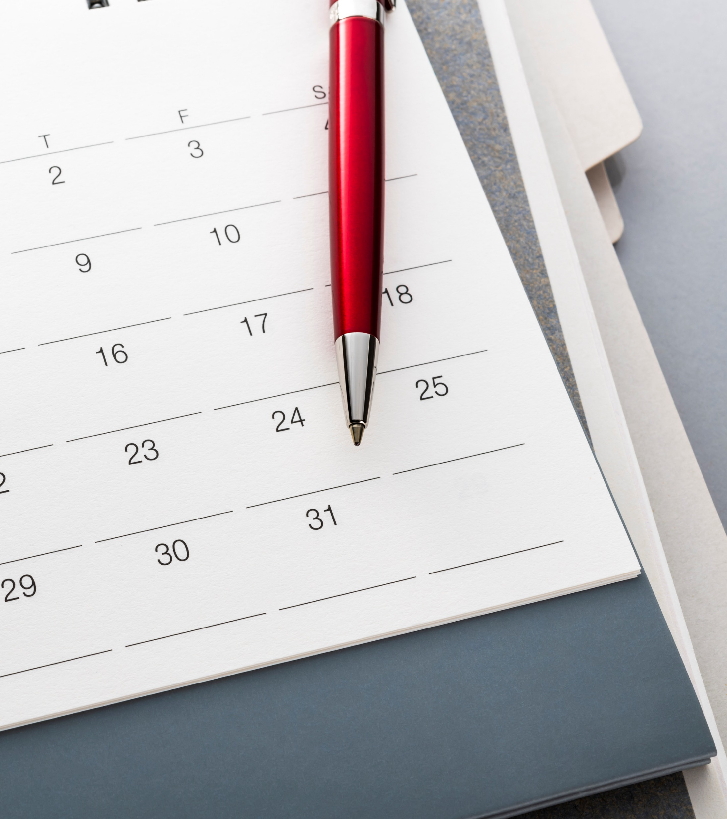
Mark your calendars
State/Presidential Election – November 5, 202
Report at 6 AM
Turn your clocks back!!!!

Slide 3
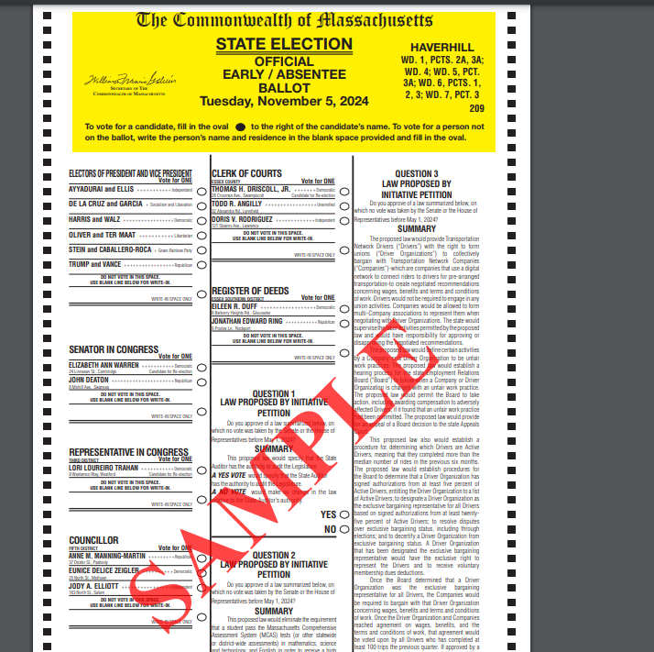
What will the ballot look like?
Locations with sub-precincts will have 2 ballot styles
Two-sided

Slide 4
OPENING OF THE POLLS
Please report to your assigned precinct at 6 AM
Pre-election Team Meeting conducted by Warden
Post specimen ballots, Voter Bill of Rights and precinct map. Ensure that access to them is not blocked.
“How to Vote” signs in booths
Turn on the AutoMARK machine
Count ballots into groups of 50
The Public has a right to view the opening procedures.
Voters CANNOT be checked in or cast a ballot until 7 AM

Slide 5
LOOK UP INSPECTORS
Double precincts only
Outside of voting area, before check in
Help to reduce lines

Slide 6
WORKING THE CHECK-IN DESK
Checking In a Voter. Ask the Voter their street name, house number, and name, then repeat it back to them. For example:
Poll Worker: “May I have your name, please?”
Voter: “John Smith”
Poll Worker: “Okay, John Smith. What is your street address?”
Voter: “12 North Main St.”
Poll Worker: “12 North Main St.”
*Enter the information in the poll pad*

Slide 7
CHECK IN CONTINUED
To make the check in process easier, you can ask a voter if they’d like to use their ID
You cannot legally require the voter to show ID
You will then scan their ID with camera on the poll pad

Slide 8
CHECK IN CONTINUED
Be sure to look out for titles such as Sr., Jr., II, III, and middle initials
Look out for twins!!!
If you cannot find them by their name, try searching their address or vice versa
If a voter cannot be found, send them to the Warden!
As always, refer to the Alpha Book!!!
NEVER TURN A VOTER AWAY

Slide 9
CHECK IN CONTINUED
Absentee/Early Ballots CANNOT BE ACCEPTED AT THE PRECINCT ON ELEC TION DAY. The voter MUST return the ballot to the Clerk’s office at City Hall.

Slide 10
BALLOT BOX ATTENDANT
Watches for “Precinct Jumpers!” if you are in a double precinct location
Sub-precincts and double locations will have stanchions
Informs voters that ballot may be inserted in any direction
Monitors tabulator for Error Messages.
Do not touch ballot box – have the voter read the message and hit Reject or Cast
DO NOT LOOK AT THE BALLOT
If voter chooses to reject their ballot, get the Warden to begin process of spoiling the ballot

Slide 11
INACTIVE CLERKS
Large number of inactive voters anticipated
Looking for people willing to help

Slide 12
OBSERVERS
THE VOTING PROCESS MAY BE OBSERVED BY PEOPLE NOT VOTING
Observers will be listening for the name and address of the Voter
Repeat the name and address of the voter in a loud, clear voice so the observer can hear
Observers are to have absolutely no interaction with voters and may only speak to Poll Workers when challenging a ballot
Observers must refrain from using cell phones in the Precinct
Observers cannot walk through the precinct to check the number on the ballot box, under any circumstances
*Let the Warden know if there any issues with Observers*

Slide 13
150 FOOT RULE
No campaigning or electioneering within 150 feet of entrance to polling location
Maps available on website and in red supply bin
Prohibited Activities within 150 feet
Black t-shirt
Enforcement of 150 Foot Rule

Slide 14
MEDIA
Media is allowed, but they cannot go further then the check in table
No pictures of ballots allowed or up close photos of voters voting
Press cannot interact with voters in the precinct
Audio recording is not allowed, video recording is okay
Poll workers MAY NOT make any statements to the press regarding the number of votes for any candidate or race, who has or has not voted, or any other statement regarding the state of the polls generally.
*Let the Warden and Police know if there any issues with the Media*

Slide 15
CLOSING OF THE POLLS
Polls close at 8:00 PM
Any person voting or in line to vote when the announcement is made by the Warden MUST BE PERMITTED TO VOTE
A Police Officer should stand in line behind the last voter to indicate no other voters may check-in
THE DOORS TO THE POLLING PLACES MUST REMAIN UNLOCKED UNTIL LEAVING FOR THE NIGHT!!!
The public is allowed to stay in the precinct to observe the closing. In addition, candidates or their committees may enter to see the result tapes posted on the wall.

Slide 16
CLOSING OF THE POLLS CONTINUED
TAKE YOUR TIME!!!
Wait for your Warden and Clerk to assign you a task
Inspectors will count the poll pad slips in sets of 25
Inspectors will count the ballots in sets of 50
Inspect all ballots for any write-ins or stray marks on ballots, that may need to be further reviewed by the warden and clerk
Inspectors will assist with placing election equipment in red bin

Slide 17
CLOSING OF THE POLLS CONTINUED
Give your final counts to the Clerk, who will complete the Clerk’s Report “End of Night Tally.”
You may not leave until your Warden and Clerk give you the okay
There is absolutely no exception to this…you have been made aware of the time commitment in advance
If you leave prior, you will not be asked to return as a poll worker

Slide 18
RESPECT FOR VOTERS
ALL UNITED STATES CITIZENS, REGARDLESS OF THEIR PROFICIENCY IN ENGLISH, HAVE THE RIGHT TO VOTE.
It is important that Poll Workers treat all Voters with respect, courtesy and customer service.
Voters with Disabilities - Use of Handicap Booth; Use of Automark Machine
Children in Voting Booths - Parents may bring their child into the voting booth with them.
Family Members in Voting Booths -Voters needing family members’ assistance may bring a family member into the voting booth.

Slide 19
PERSONAL POLITICS
Leave your politics at the door!
We are here to serve ALL voters regardless of how they vote or who they vote for
You are a representative of the City of Haverhill, and your behavior reflects on the City

Slide 20
POLITICAL DISCUSSIONS
There are to be ABSOLUTELY NO political discussions under any circumstances
Do not wear any sort of political attire
This goes for both you and the voter…
If the voter is discussing politics, you must ask them to take their discussion outside
If the voter is wearing political attire (someone on the ballot), you must ask them to leave and return without that article of clothing on
I.E. No Trump and Biden gear
If the voter causes an issue, get your Warden and the Police Officer assigned to your precinct

Slide 21
EXPECTATIONS
The parking spots closest to the entrance MUST BE RESERVED FOR VOTERS. If you need a handicap spot, please remember that your car will be parked all day, and voters needing handicap spots throughout the day will not have access to it. Please use the spots as close as possible to the handicap spaces.
All workers should be on the lookout for voters who need assistance in the Precinct.
Do not leave your post without checking with the Warden
Dress in layers as requests for heat/air conditioning cannot be made to please everyone.
Be flexible. You may be asked to work in a different capacity than you are used to.
Keep your cell phone on vibrate/silent. Keep texting and social media to a minimum.
All Election Workers must stay in the Precinct until the votes have been counted and everything is balanced.

Slide 22
LUNCH BREAK AND PAY
All poll workers are allotted a two-hour lunch break
Morning of election your Warden and Clerk will arrange lunch schedule with you and your fellow Inspectors
You must take your lunch break no later than 3 PM
All workers should be back from break by 5 PM
You will be paid $245 for the day – Full day inspectors
Checks will be issued two weeks after the election on Thursday November 21st
If you are a new poll worker this election, you must complete a W9 form before being paid
If you have not yet filled one out, please approach me after training

Slide 23
Make a Plan to Vote
Vote on Election Day if you work at your precinct or vote on lunch break
Early Voting
Vote by Mail

Slide 24
QUESTIONS?

